Slide 1


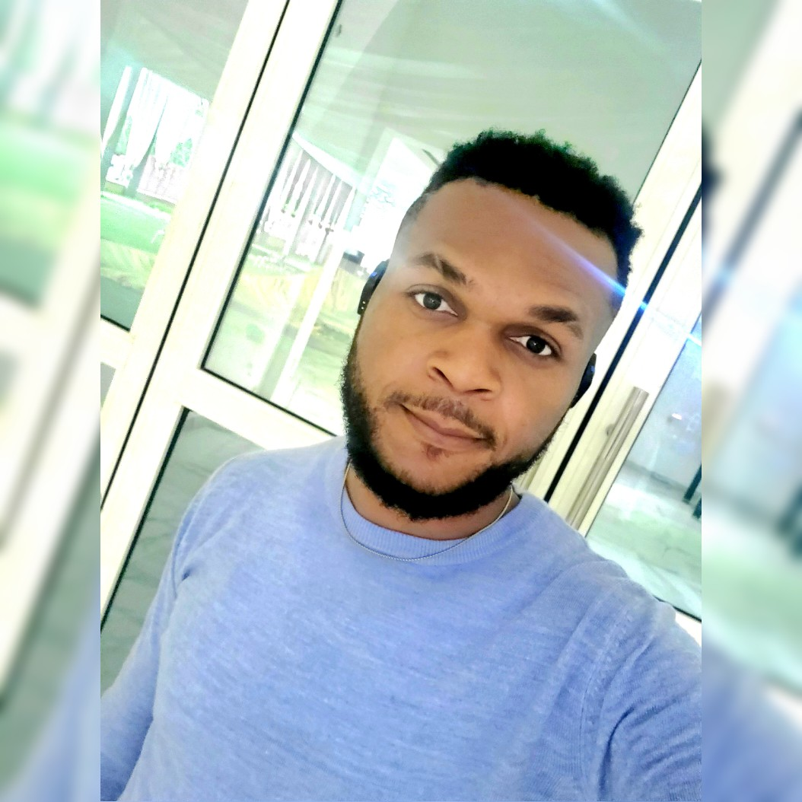
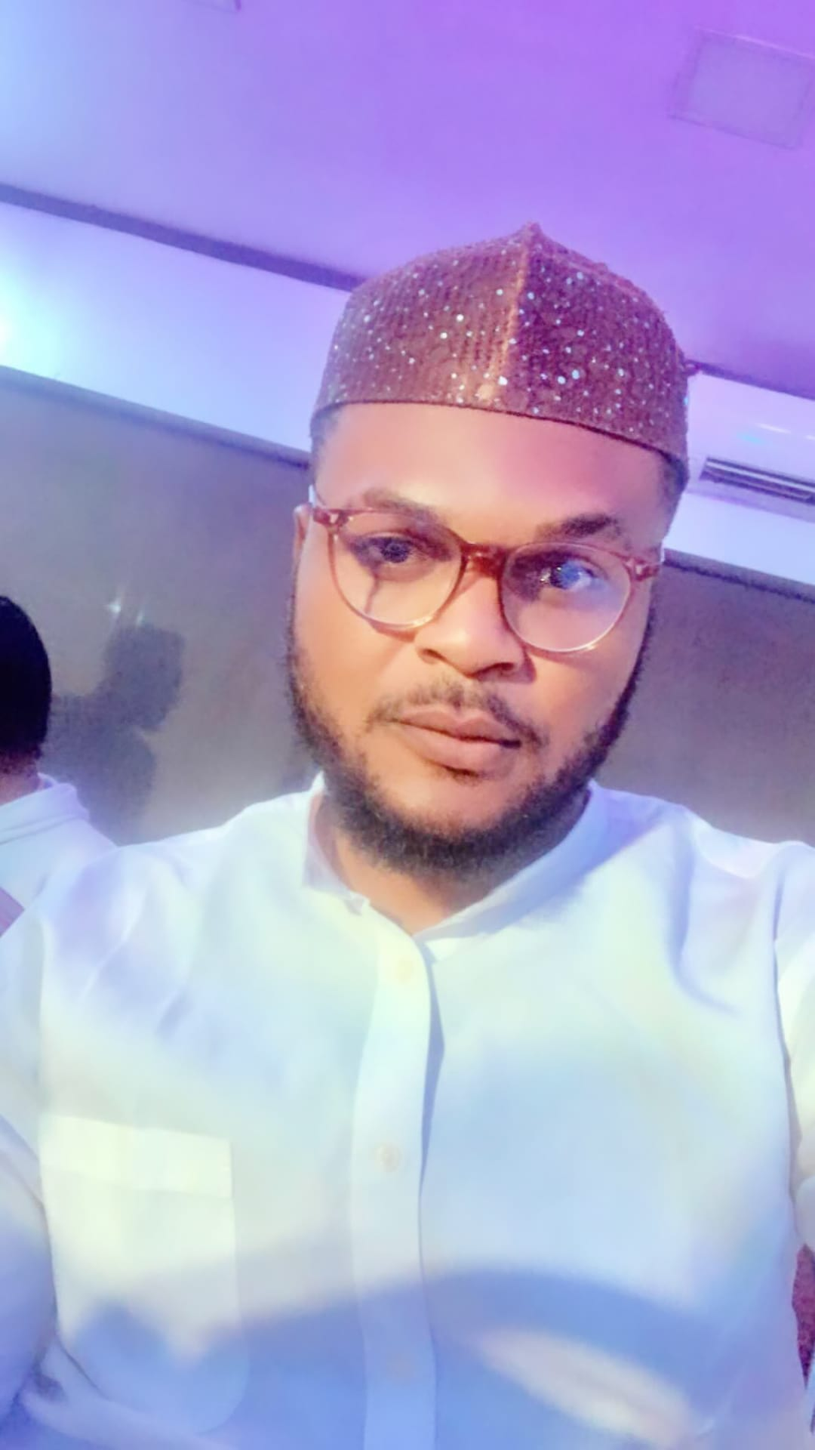
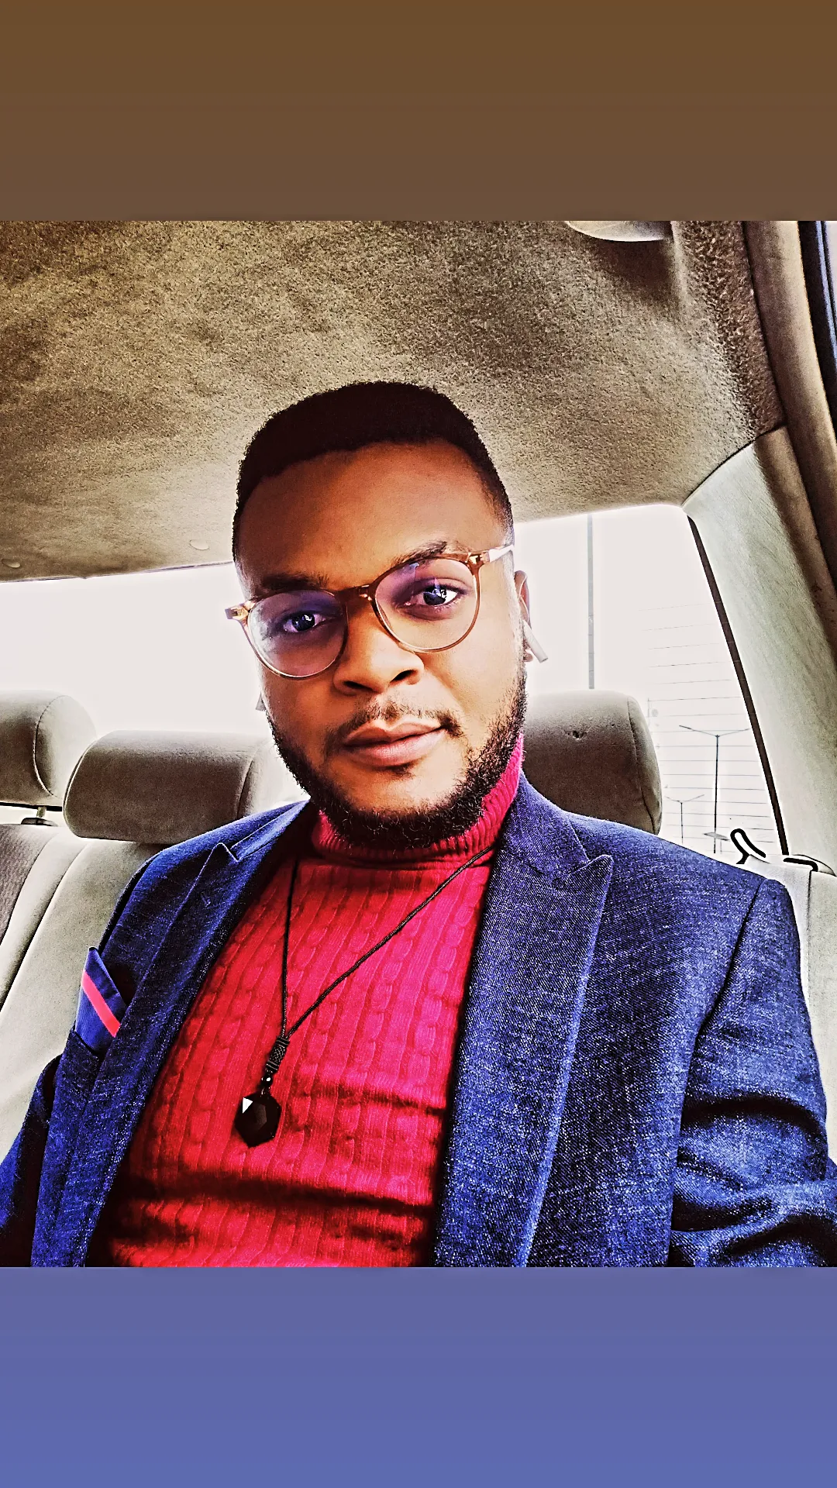
Getting to Know Me
Work
Personal
My role
Legal Manager
Significant others / family members / furry friends in my life
6 Siblings, Mom & Dad and a barrage of amazing friends
Tenure in ofi/Olam
5years
How I enjoy spending my free time
Locked in a good book, Swimming and listening to classical songs
Previous companies I have worked at
Falana & Falana Chambers
My favorite / comfort food
Plantain Pottage with Fish
Why I joined ofi/Olam and what keeps me here?
To have a diverse and immersive corporate experience and I stay because that desire has only been fueled, and it's been truly rewarding
My favorite song
Back to Black by Amy Winehouse
Kesiena Ekutu
‘SAGE’
A few fun facts about me
Sci-Fi Geek and once auditioned to be a Music Jockey at MTVBase
This is me outside work, doing stuff I enjoy in my life …

